Slide 1
Enacting Distributed HPC Workflows: Opportunities and Challenges
Feb 20-21, 2025, UCR and UCI
Ketan Maheshwari
NCCS / OLCF, Oak Ridge National Laboratory

Slide 2
Acknowledgements
Thanks to Profs. Tsotras (UCR), Eldawy (UCR), Li (UCI), Jahangiri (SCU) for the invites and organization.
Thanks for the support at UCR: Gerardo and UCI: Jamie
The work presented used resources of the Oak Ridge Leadership Computing Facility at the Oak Ridge National Laboratory, which is supported by the Office of Science of the U.S. Department of Energy under Contract No. DE-AC05-00OR22725
Thanks to colleagues at Oak Ridge and many collaborators who have contributed and enriched the work presented.

Slide 3
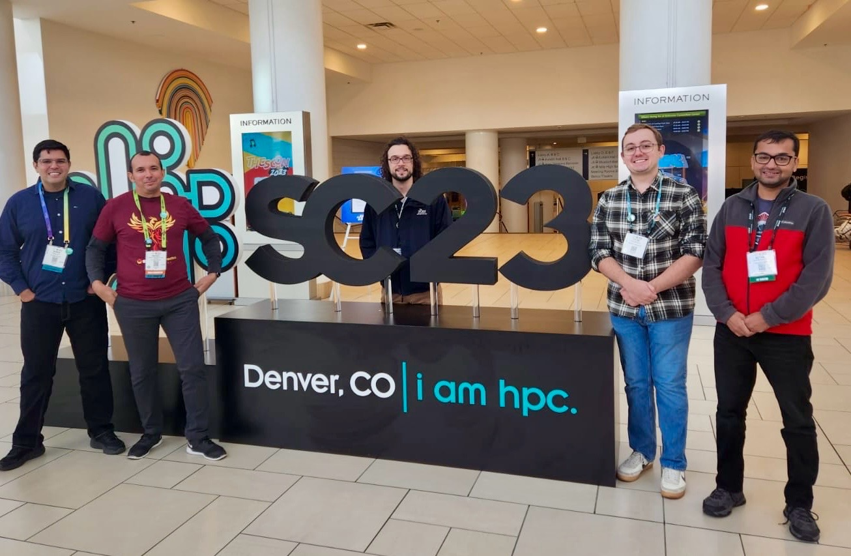
About me
Senior Engineer at Oak Ridge National Laboratory
Part of the NCCS Division / OLCF Program
Workflows and Ecosystem Services: Fast growing group of 9 as of 1/2025
Specialize in Science Workflows
Interested in HPC-Science applications, porting, deployment and troubleshooting aspects
Postdoc at Argonne National Laboratory and Cornell
PhD in Scientific Workflows area, Univ of Nice, France

Slide 4
Overview
Context: The DOE Complex
Workflows: What, Why, How, State of the art
The Various Aspects of Workflows
Representation and UI / UX
Data
Parallelism
Scheduling
Distributed Workflows
Opportunities : Leveraging DOE Capacities and Capabilities
Challenges : Technical, Technological, Social / Cultural

Slide 5
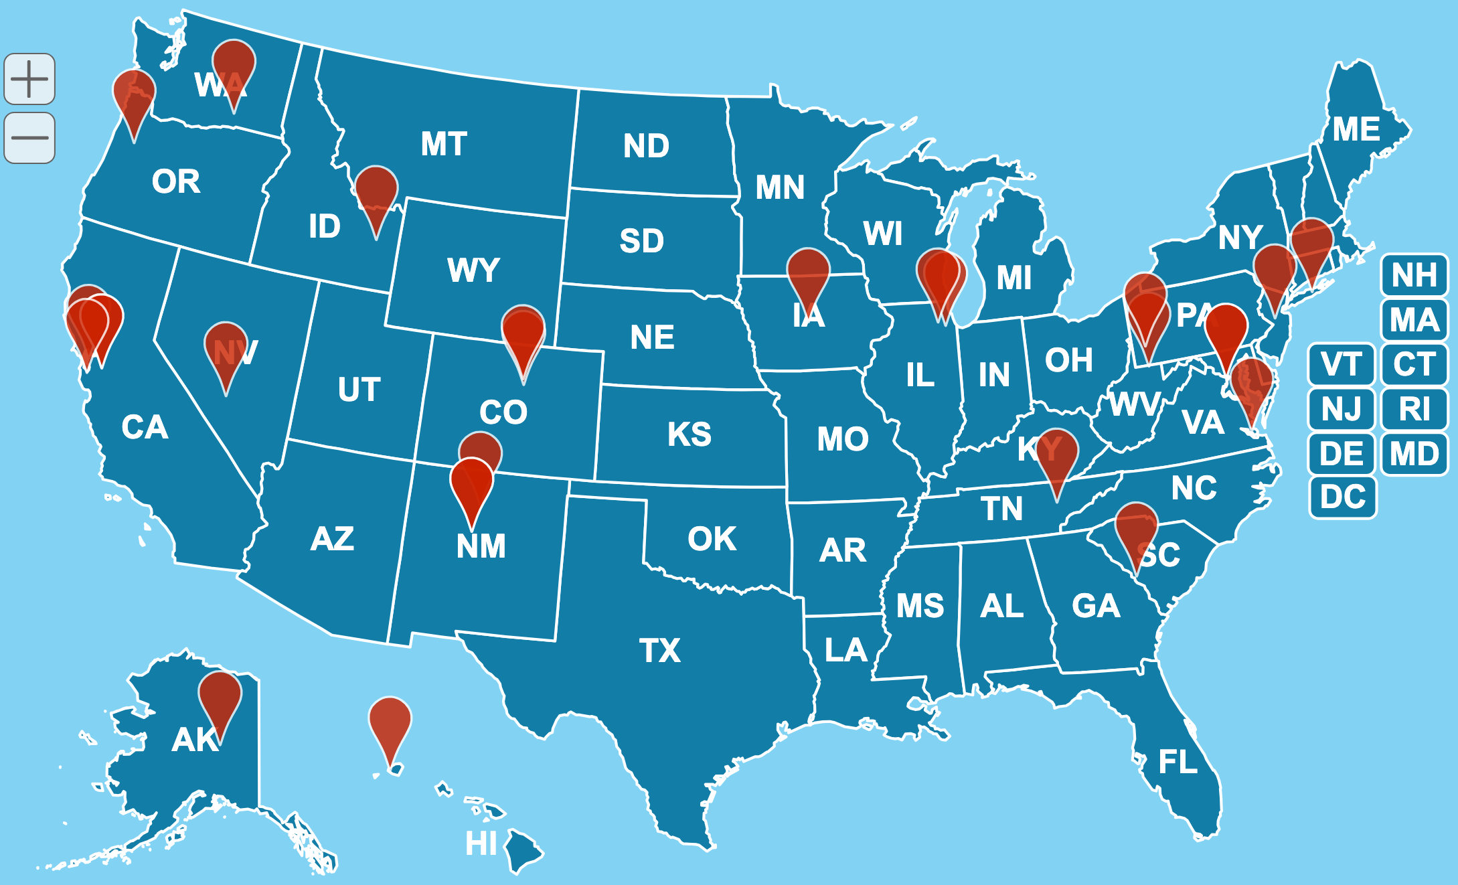
The Department of Energy (DOE) Complex: Seventeen Laboratories across the nation, a variety of Facilities
Geographically and administratively distributed
Data Producing Facilities such as APS, SNS
Data Producing Field Research such as Transportation and BioSciences research
Data Processing Facilities such as OLCF, ALCF, NERSC
Projects allocated to wider community including Universities and commercial entities
https://www.energy.gov/articles/map-explore-national-labs

Slide 6
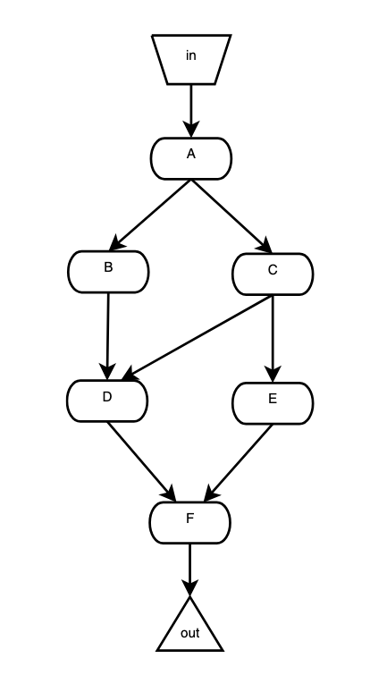
What are Workflows
Computations that are organized as multi-stage / multi-phase processes
Often represented as Directed Acyclic Graphs (DAG)
Traditionally used for business processes
Increasingly popular among computational science communities
Automate a sequence of interrelated computations
docs.olcf.ornl.gov/software/workflows/index.html
K. Maheshwari and J. Montagnat, "Scientific Workflow Development Using Both Visual and ScriptBased Representation,"6th World Congress on Services, Miami, FL, 2010,

Slide 7
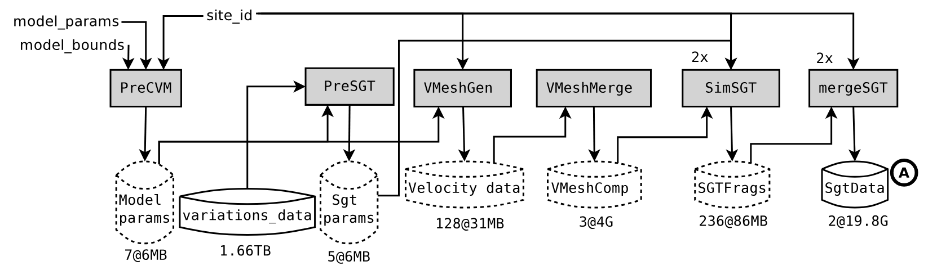
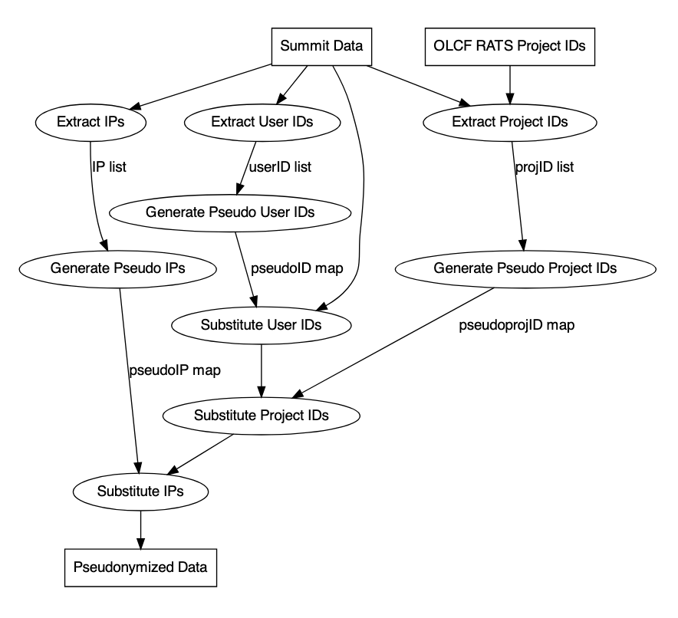
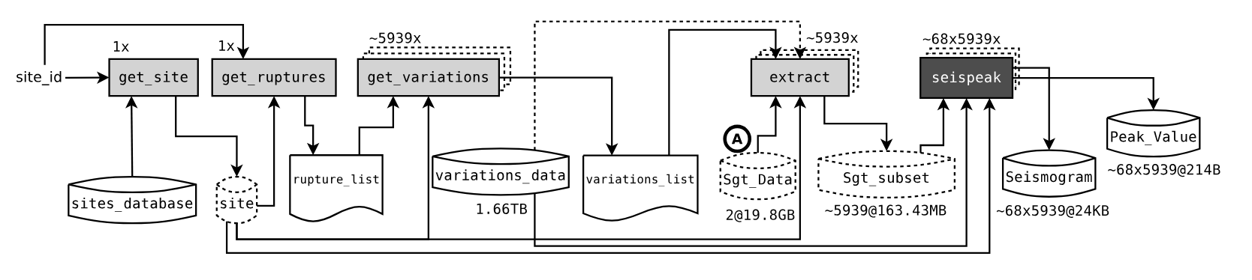
Illustrative Examples of Real-World Workflows
K. Maheshwari et al. "Pseudonymization at Scale: OLCF’s Summit Usage Data Case Study," 2022 IEEE International Conference on Big Data, Osaka, Japan, 2022, pp. 3432-3440, doi: 10.1109/BigData55660.2022.10020380. K. Maheshwari, A. Espinosa et al, 2012. Job and data clustering for aggregate use of multiple production cyberinfrastructures. In Proceedings of DIDC ‘12, ACM, New York, NY, USA, 3–12. https://doi.org/10.1145/2286996.2287000

Slide 8
Why are Workflows Required?
Define and capture a scientific campaign
A live, executable unit of communication and documentation
Automation of complex computational stages that may require different environments: tedious to perform manually
Repeatable with minimal errors and mistakes
May run on multiple platforms providing flexibility in scale and deployments
Leverage parallelism and concurrency offered by the computational platform

Slide 9
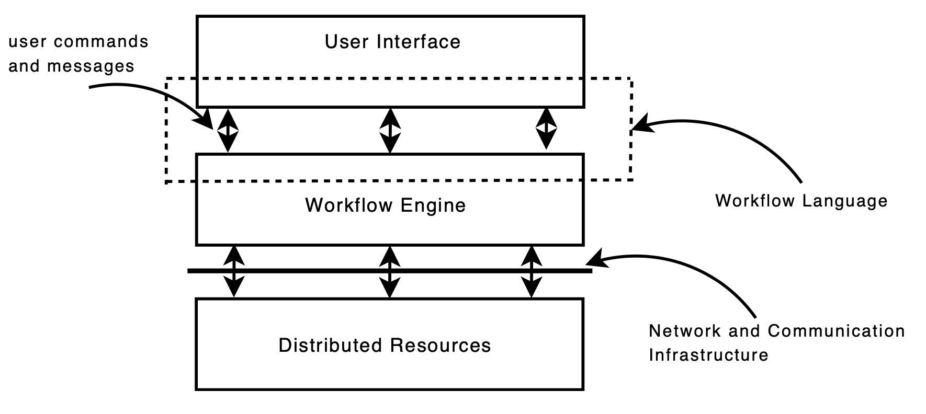
How: Workflow Management Systems
Facilitate Workflow Composition / Development
Automate optimal execution
Interface with computation resources
Hundreds of Workflow Systems available
Parsl, EnTK, Swift/T, Nextflow, Airflow, Dask, Snakemake are a few leading Workflow Management Systems

Slide 10
Workflow Management Systems: User Interface
Three kinds of user interfaces are common
A standalone graphical user interface (GUI) such as Texera, Galaxy
A text-based programming-style interface such as Swift/T, Parsl, NextFlow
A web-based graphical interface such as Cloudflows
Workflow Management Systems provide templates and examples

Slide 11
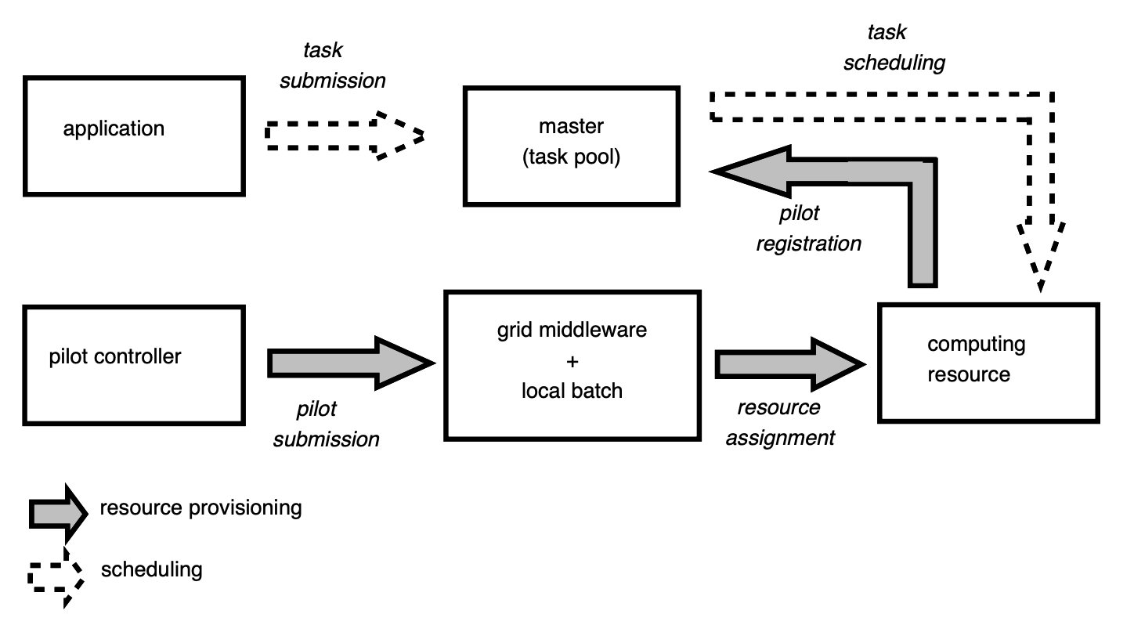
Workflow Management Systems: Task Scheduling
Automatic identification of data dependencies
Task grouping and Gang scheduling
Direct vs indirect interaction with the job schedulers
Pilot job systems

Slide 12
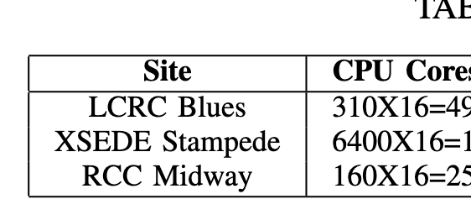
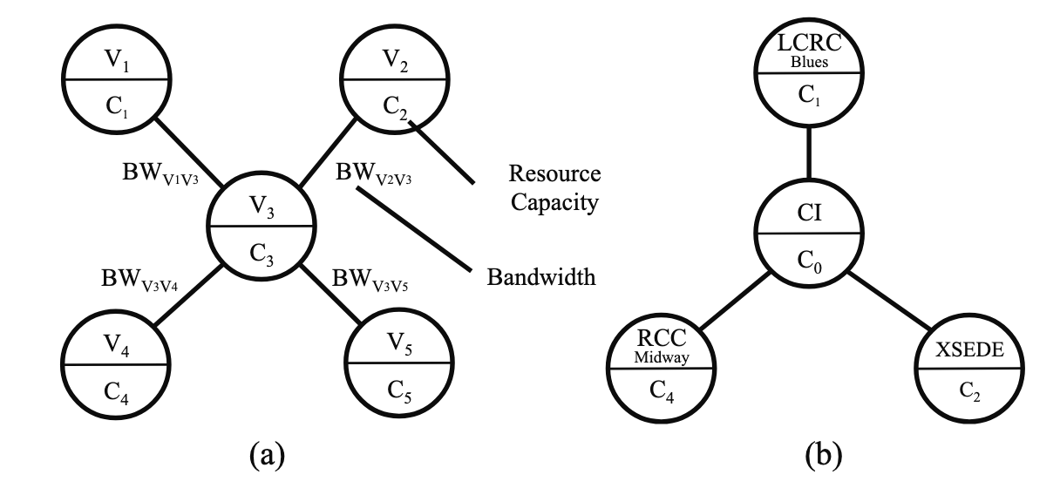
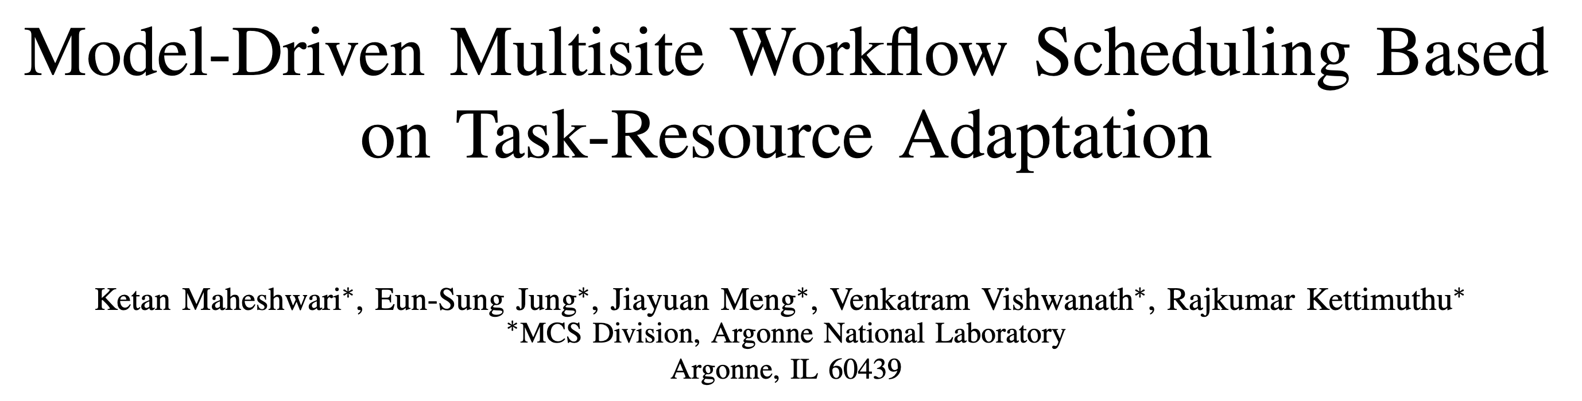
Distribute Workflows: Multisite Execution in Simpler Times
-- sites accessible via ssh key-based auth
-- Relatively simpler cybersecurity / firewalls
configurations
-- uniform scheduling interface

Slide 13
Distributed HPC Workflows: State of the Art
Mostly ad-hoc approaches
No workflow systems developed from scratch to handle Distributed Workflows

Slide 14
Distributed HPC Workflows: Unification is the Biggest Opportunity
To bring about a culture of computing where in a user would view a computer located in any of the DOE facility as easily accessible as the one on their desk or even in their pocket
Workflows are poised to play a crucial role in this endeavor
SNS@ORNL
providing data
Analyses at NERSC
Analyses at ANL
Evaluation / Comparison at OLCF

Slide 15
Distributed HPC Workflows Challenge - I : Heterogeneous Job Management Environments
Opportunity: Develop an API that abstract away the heterogeneity of the

Slide 16
Distributed HPC Workflow Challenge - II : Cybersecurity
Opportunity: Steer the remote communications over known, secure and standard channels
Leverage shared data infrastructure such as message based systems, share filesystems, distributed frameworks

Slide 17
“Last-Mile” Parallelization: How to run a bag-of-tasks in Parallel?
MPI-based that is often built into applications such as NAMD, VASP, NWChem
Some workflow systems provide MPI as task parallelization backbone
Code integration libraries such as OpenMP
ad hoc via running processes in background over loops
Task based run-time parallelization such as GNU Parallel

Slide 18
Exploration of GNU-Parallel as a Viable Parallelization for Workflows

Slide 19
Thank You for your time! Questions?
maheshwarikc@ornl.gov

